Slide 1
Fuel Types
NE 591

Slide 2
Fuel is the Heat Source
Fuel functions as a heat source, generating heat that is transferred to a coolant, which transfers heat through external loops, heat exchangers, etc., to run a generator

Slide 3
Fuel is limited to select elements
A fissionable nuclide is capable of undergoing fission (even with a low probability) after capturing a high energy neutron
A fissile nuclide is capable of sustaining a nuclear fission chain reaction with neutrons of any energy
A fertile material is a material that, although not itself fissionable, can be converted into a fissile nuclide by neutron absorption and subsequent nuclei conversions.
The Ronen fissile rule states that for a heavy element with 90 ≤ Z ≤ 100, its isotopes with neutrons (A-Z) = 2 × Z – N, where N = 43 ±2 are fissile (with some exceptions)

Slide 4
Potential fuel candidates
The heavy elements with 90 ≤ Z ≤ 100
Thorium (Th), Protactinium (Pa), Uranium (U), Neptunium (Np), Plutonium (Pu), Americium (Am), Curium (Cm), Berkelium (Bk), Californium (Cf), Einsteinium (Es) and Fermium (Fm)
Lets apply the fissile rule to U (2 × Z – N)
(A-Z) = 2 Z – (43 ± 2)
(A-Z) = 2 × 92 – [41, 42, 43, 44, 45] = [143, 142, 141, 140, 139] neutrons
So, U-231 through U-235 should be fissile

Slide 5
There are only four fissile nuclides that are practical for nuclear fuel
U-235
Naturally occurs in uranium in small amounts (0.7%). Can be enriched
Pu-239
Bred from U-238 by neutron capture
Pu-241
Bred from Pu-240 (which comes from Pu-239) by neutron capture
U-233
Bred from Th-232 by neutron capture

Slide 6
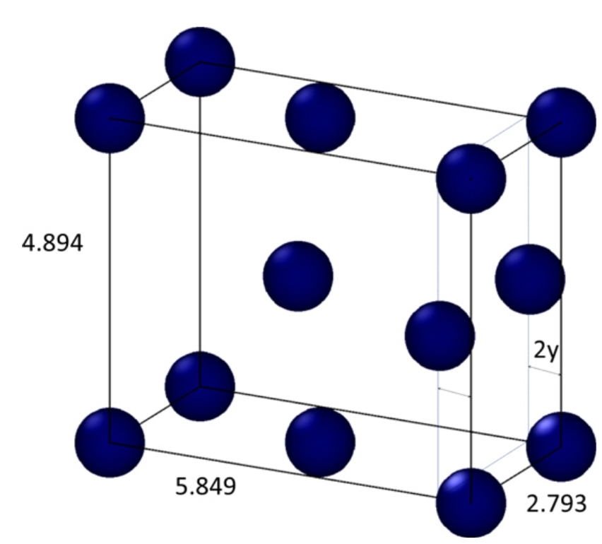
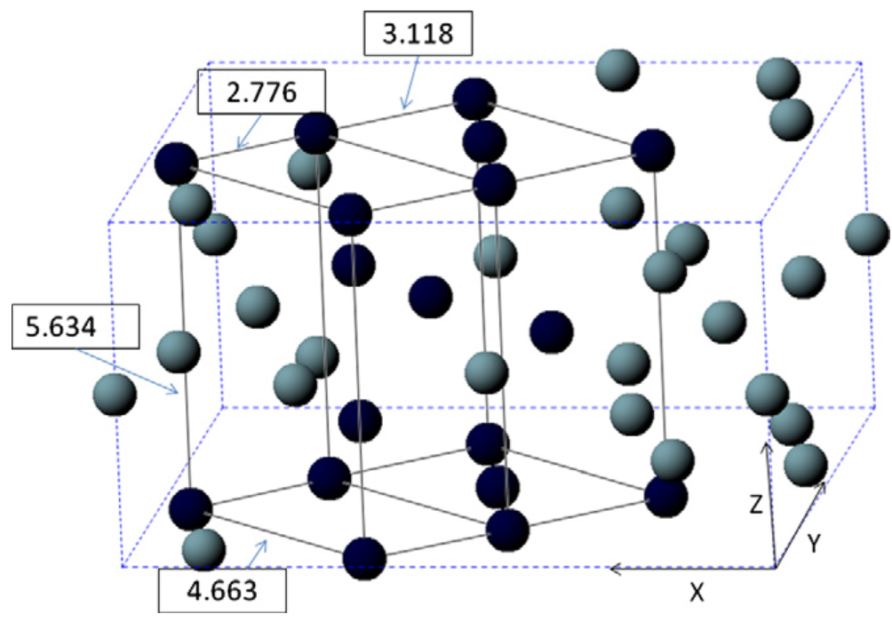
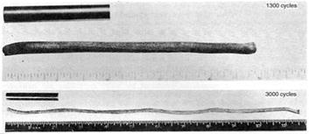
Why not use pure uranium metal?
Pure uranium has three phases
α-phase is orthorhombic
β-phase is tetragonal
γ-phase is body-centered cubic
During thermal cycling, pure uranium dramatically swells
Alpha U has both anisotropic thermal expansion and anisotropic irradiation growth

Slide 7
Fuel Types and Associated Reactor Types
UO2 – Light Water Reactors
Mixed oxide (MOX)
Accident tolerant/Advanced Technology Fuel (ATF)
UZr – Sodium Cooled Fast Reactors
UMo – Research Reactors
UC/UCO – High Temperature Gas Reactors
UN – Lead Cooled Fast Reactors

Slide 8
Fuel Considerations
Safety:
Stable and predictable behavior
No melting, no phase changes under transients that lead to deleterious behavior
Uranium density
Mechanical integrity
Cladding interactions
Swelling and fission gas release
Operating temperatures

Slide 9
Uranium Dioxide (UO2)
Reference fuel for nuclear power industry
Single phase, fluorite structure
Fabrication via sintering UO2 powder into pellets
Water coolant
Pellets are stacked inside Zircaloy cladding tubes

Slide 10
Uranium Dioxide (UO2)
Good!
Very high melting point, about 2800 C
Maintains a stable fluorite phase up to melting
Very compatible with Zircaloy clad (no interaction zones forming/no FCCI)
Relative stability in water
Reasonably radiation resistant
no amorphization
Can incorporate a large number of fission products as substitutional defects

Slide 11
Uranium Dioxide (UO2)
Bad!
Brittle
thermal stress fractures, fragmentation
Poor thermal conductivity
Properties very sensitive to stoichiometry
Limited linear heating rates
Non-negligible thermal expansion/swelling
Higher stored thermal energy than other fuel materials

Slide 12
Uranium Dioxide (UO2)
Critical Phenomena
Thermal conductivity (and degradation)
Fission gas release, leading to pressure increase inside the cladding
Fuel fragmentation and relocation under transients
Bambooing creating stress concentrations
All 98 operational reactors in US utilize UO2

Slide 13
Mixed Oxides (MOX)
Can be combined with PuO2 for a mixed oxide (MOX) fuel for use in fast reactors
Allows to burn excess weapons grad plutonium
About 30 reactors in Europe currently utilize a partial MOX core
Similar behavior to UO2, but different neutronics, fission gas release, thermal conductivity, etc.
Less common is inclusion of minor actinides in MOX to burn waste

Slide 14
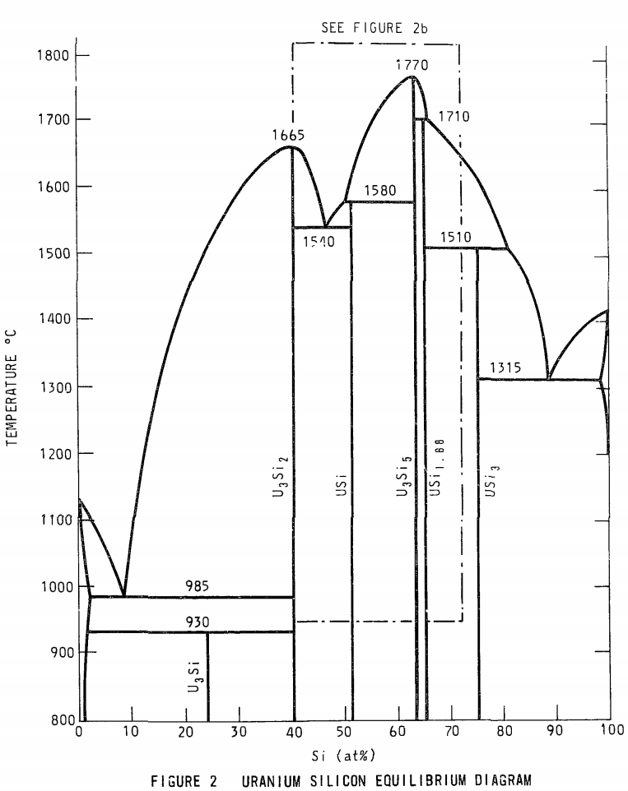
Accident Tolerant Fuel/Advanced Technology Fuel
Kept the acronym, changed the concept
USi fuels (U3Si2)
A metal-ish compound, with higher thermal conductivity, higher uranium density
Complex crystal structure (10 atoms unit cell) with effectively two sub-lattices
Amorphizes at low temperatures
Poor oxidation resistance
Will require improved cladding, liners/coatings or fuel dopants

Slide 15
Accident Tolerant Fuel/Advanced Technology Fuel
Cr-doped UO2
Larger grain size, theoretically reduced fission gas release
Cr changes the O potential present within the fuel, changing defect concentrations and mobilities
Coatings or alternate claddings – FeCrAl or SiC
Improved radiation resistance, corrosion resistance, etc.

Slide 16
Uranium-Zirconium (UZr)
Utilized in sodium cooled fast reactors (SFRs)
EBR I, EBR II
Varied crystal structure and compositional environment
Easily alloyed with Pu, minor actinides (MA)
Can function as a breeder/burner fuel
Sodium coolant
Fe-based cladding

Slide 17
Uranium-Zirconium (UZr)
Alloy metallic U with Zr to increase the melting point and to stabilize the high temperature body-centered cubic phase
Interesting phenomena
30-50% swelling
Constituent redistribution
Alpha tearing
FCCI

Slide 18
Uranium-Zirconium (UZr)
Good!
High thermal conductivity
Stability to high burnups (> 20%)
Flexible composition
Inherent safety- negative reactivity feedback
Good compatibility with Na coolant
Bad!
Low melting point
Dramatic fuel swelling that must be accounted for
Incredibly complex microstructures/unpredictable behavior
Fuel-Clad Chemical Interaction
Very easily oxidized

Slide 19

Uranium-Molybdenum (UMo)
New fuel being qualified for research reactors
Fuel foil, with Zr diffusion barrier, Al cladding
Will be utilized in ATR, NBSR, MITR, MURR

Slide 20
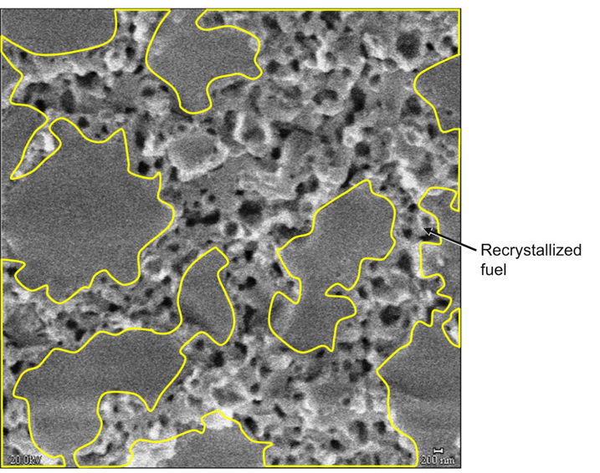
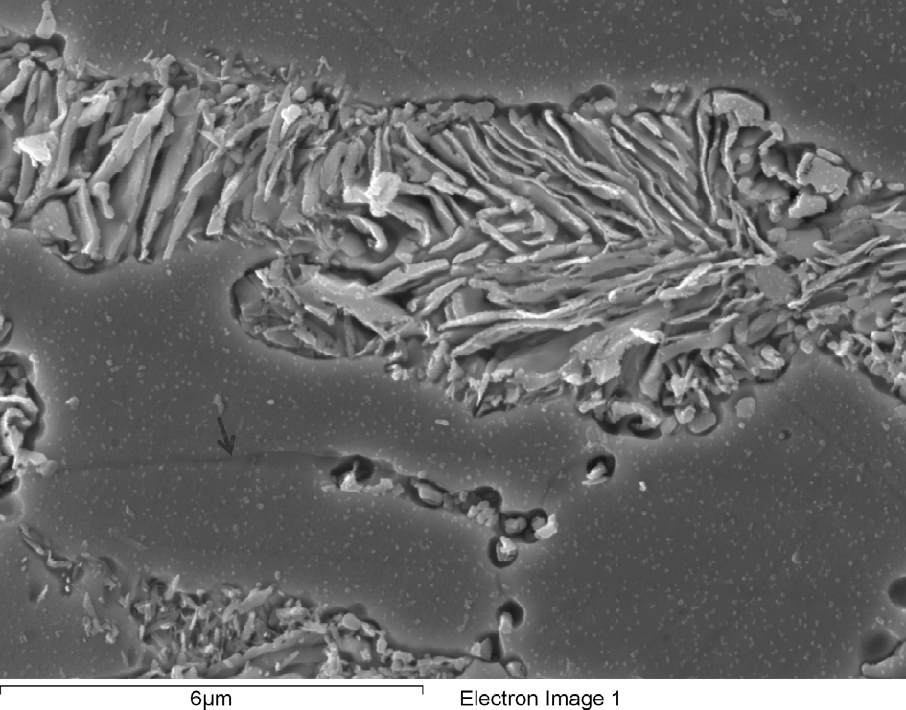
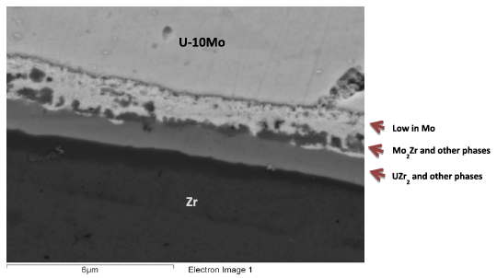
Uranium-Molybdenum (UMo)
Microstructural phenomena of interest:
Decomposition
Fission Gas Superlattice
Recrystallization
Inter-diffusion region
Carbides

Slide 21
UC/UCO TRISO Fuels
TRISO: TRistructural ISOtropic particle fuel
Layered fuel in mm-sized particles
Layers:
Fuel Kernel
Buffer
Inner Pyrolitic Carbon (IPyC)
SiC
Outer Pyrolitic Carbon (OPyC)

Slide 22
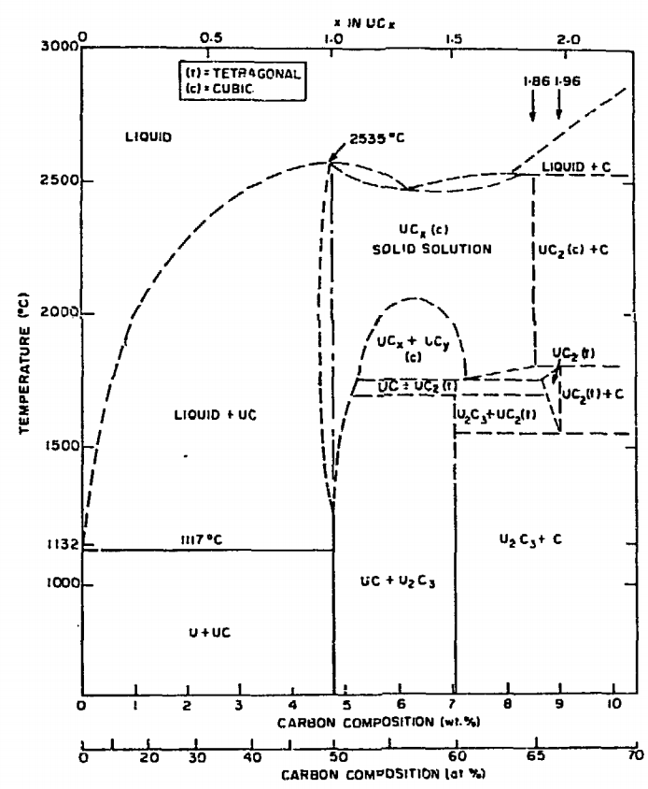
UC/UCO TRISO Fuels
Can appear as UC, U₂C₃, or UC₂
Advantages
High thermal conductivity
High fuel density
Thermally stable
High melting temperature
Disadvantages
Rapidly corrodes in water
Reacts with some cladding

Slide 23
UC/UCO TRISO Fuels
High temperature gas reactors (HTGR) or molten salt reactors (MSRs)
Pebble bed and prismatic types
Particles are agglomerated with graphite into a larger pebble, or into a cylindrical block
Current designs utilize UCO, which is a heterogeneous mixture of UO2 and UC fuel
Helium cooled gas or molten salt cooled

Slide 24
UC/UCO TRISO Fuels
Each individual pebble acts as its own containment, and allows fuels to go to much higher burnups and higher temperatures than UO2
Highly reliant on accurate fabrication processes that create high integrity, uniform layers and spherical particles
Integrity of the SiC is key for fission product retention

Slide 25
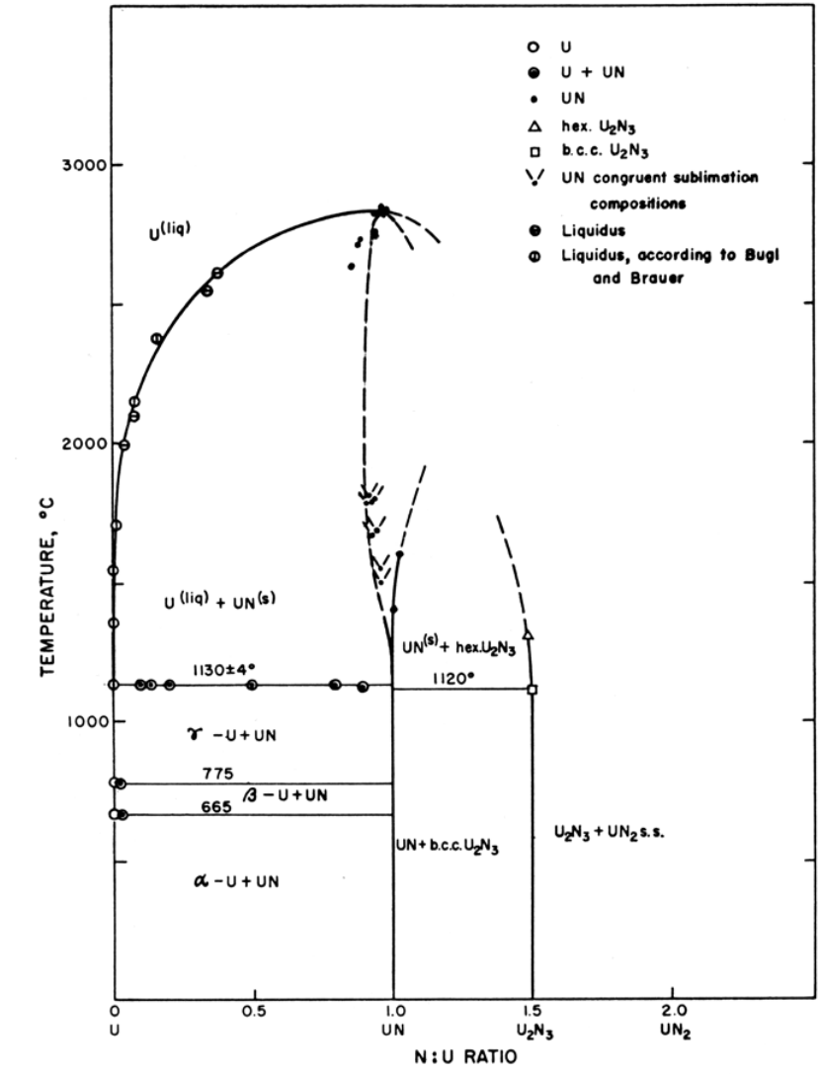
UN – Lead Cooled Reactors
Can appear as UN, U₂N₃, or UN₂
Advantages
High thermal conductivity
High fuel density
Thermally stable
High melting temperature
Disadvantages
Corrodes in water
Reacts with some cladding
Difficult to manufacture
Requires N-enrichment

Slide 26
Unique Fuel Designs
Lightbridge
High Zr content UZr alloy
Cruciform geometry fuel rods, combined into fuel elements
Kairos
TRISO particle compacts with low density core
Float in molten salt coolant for online refueling

Slide 27
Unique Fuel Designs
NASA/LANL
UMo fuel for space reactors: KRUSTY
Stable Salt Reactor (SSR)
Dissolved molten salt fuel
NaCl-U-Pu-stuff

Slide 28
Fuel Summary Table
Property | UZr | UO₂ | UC | UN | U₃Si₂
Corrosion resistance in water | Very poor | Excellent | Very poor | Poor | Poor
Compatibility with clad materials | Reacts with normal clad | Excellent | Variable | Variable | Variable
Thermal stability | Phase change at 665 and 770 °C | Good | Good | Good | Good
Uranium (metal) density (g/cm³) | 19.04 | 9.65 | 12.97 | 13.52 | 11.31
Melting point (°C) | 1132 | 2865 | 2850 | 2860 | 1665
Thermal conductivity (W/m-K) | 38 at 430 °C | 3 at 1000°C | 25 at 500°C | 20 at 750°C | 23 at 773°C

Slide 29
Fuel Types Summary
There exist a number of nuclear fuels in different stages of utilization and development
Each reactor design or application has individual needs, and no one fuel is one size fits all
Need to balance safety, performance (normal, off-normal, extended), manufacturability, processing, waste, etc.

Slide 30
Questions/Comments/Summary
Primary purpose of fuel is heat source
Uranium is most viable candidate for nuclear fuel materials
Uranium is combined with O, C, N, transition metals for a variety of fuel types
UO2: ceramic, commercial reactor fuel, light water reactors
ATF: U3Si2 and Cr-doped UO2
UZr: fast reactor fuel
UMo: research reactor fuel
UC/UCO: high temperature gas reactors

